Slide 1
LEADS SCORING CASE STUDY
PRATIKSHA SHINDE

Slide 2
INDEX
PROBLEM STATEMENT
BUSINESS OBJECTIVE
SOLUTION METHODOLOGY
DATA MANIPULATION
EDA
MODEL BUILDING
PREDICTION ON TEST SET
CONCLUSION

Slide 3

PROBLEM STATEMENT
▶ X Educationsells online courses to industry professionals.
▶ X Education gets a lot of leads, its lead conversion rate is very poor. For example, if, say, they acquire 100 leads in a day, only about 30 of them are converted.
▶ To make this process more efficient, the company wishes to identify the most potential leads, also knownas ‘Hot Leads’.
▶ If they successfully identify this set of leads, the lead conversion rate should go upas the sales team will now be focusing more on communicating with the potential leads rather than making calls to everyone.

Slide 4
BUSINESS OBJECTIVE
▶ X education wants to know most promising leads.
▶ For that they want to build a Model which identifies the hot leads.
▶ Deployment of the model for the future use. S

Slide 5
SOLUTION METHODOLOGY
1. Check and handle duplicate data.
2. Check and handle NA values and missing values.
3. Drop columns, if it contains a large number of missing values and are not useful for the analysis.
4. Imputation of the values, if necessary.
5. Check and handle outliers in data.
1. Univariate data analysis: value count, distribution of variables, etc.
2. Bivariate data analysis: correlation coefficients and pattern between the variables etc.
3. Feature Scaling & Dummy variables and encoding of the data.
4. Classification technique: logistic regression is used for model making and prediction.
5. Validation of the model.
6. Model presentation.
7. Conclusions and recommendations.

Slide 6
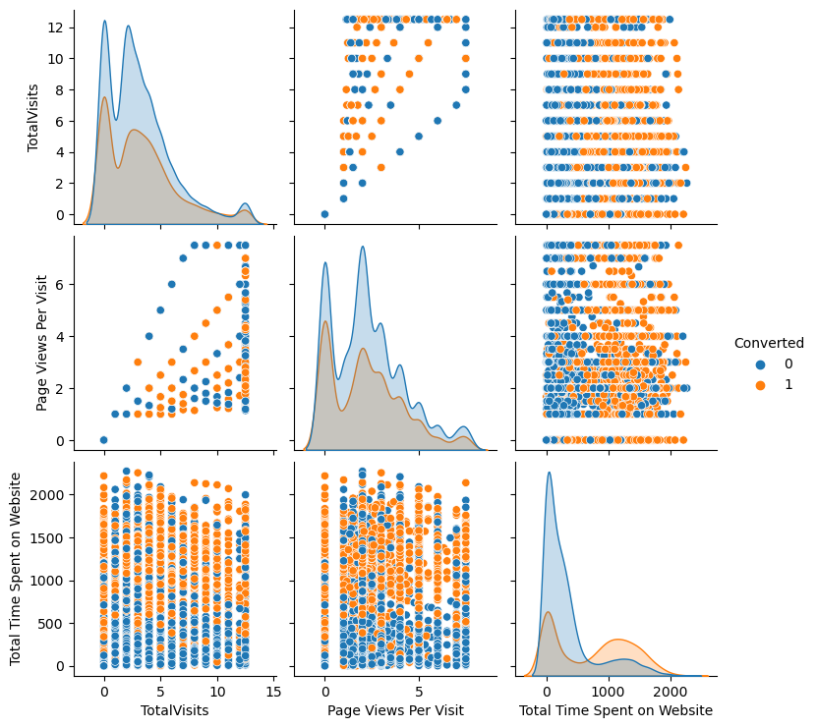
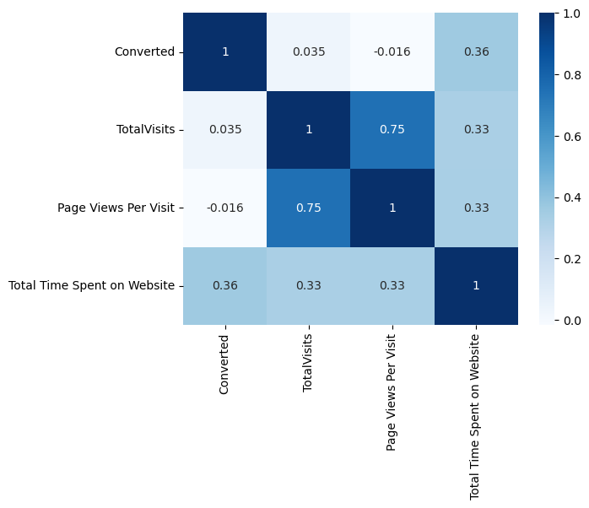
EXPLORATORYDATA ANALYSIS (EDA)

Slide 7
MODEL BUILDING
Splitting the Data into Training and Testing Sets
▶ The first basic step for regression is performing a train-test split, we have chosen 70:30 ratio.
▶ Use RFE for Feature Selection
▶ Running RFE with 15 variables as output
▶ Building Model by removing the variable whose p-value is greater than 0.05 and vi value is greater than 5
▶ Predictions on test data set
▶ Overall accuracy 81%

Slide 8
PREDICTION ON TEST SET
▶ Before predicting on the test set, we need to standardize the test set and need to have exact same columns present in our final train dataset.
▶ After doing the above step, we started predicting the test set, and the new prediction values were saved in a new data frame.
▶ After this we did model evaluation i.e. finding the accuracy, precision, and recall.
▶ The accuracy score we found was 0.82, precision 0.75, and recall 0.75 approximately.
▶ This shows that our test prediction is having accuracy, precision, and recall scores in an acceptable range.
▶ This also shows that our model is stable with good accuracy and recall/sensitivity.
▶ Lead score is created on test dataset to identify hot leads – high the lead score higher the chance of conversion, low the lead score lower the chance of getting converted. It was found that the variables that mattered the

Slide 9
CONCLUSION
It was found that the variables that mattered the most in the potential buyers are (In descending order) :
▶ The total time spent on the Website.
▶ Total number of visits.
▶ When the lead source was: Google Direct traffic Organic search Welingak website
▶ When the last activity was: SMS Olark chat conversation
▶ When the lead origin is Lead add format.
▶ When their current occupation is as a working professional. Keeping these in mind X Education can flourish as they have a very high chance to get almost all the potential buyers to change their mind and buy their courses.

Slide 10
thank you

